Slide 1
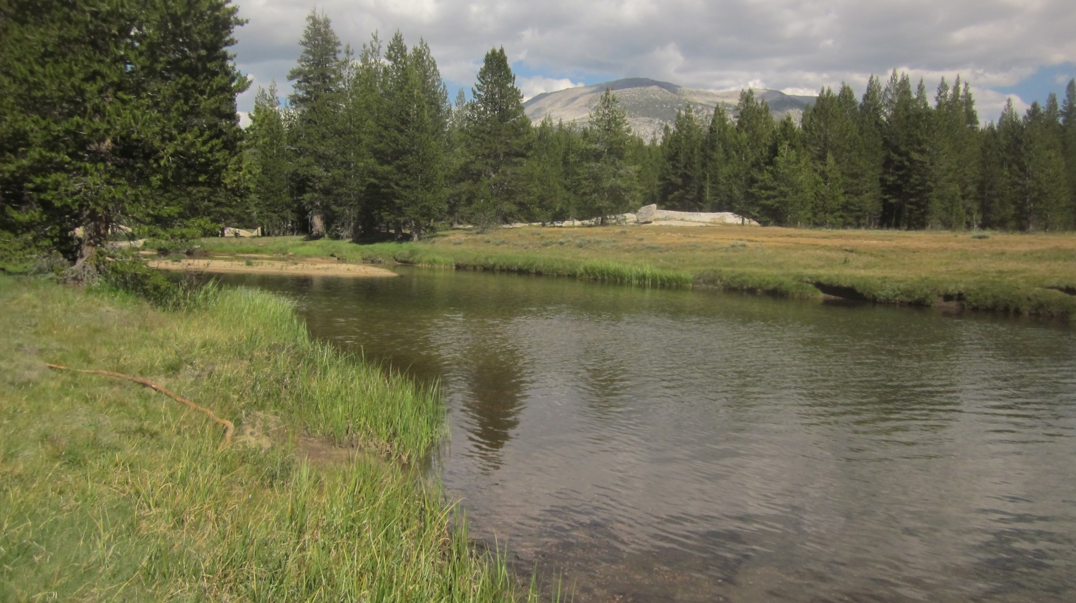
Lyell Above Twin Bridges Gage:
updated 7/17/2015
FLOW
Photo: 6/24/2015
Initial Solinst stilling tube install: 2002
Bolt benchmark install: 7/15/2015
CR1000 & CS450 P.T install: 7/16/2015
Photo: 7/24/2012

Slide 2
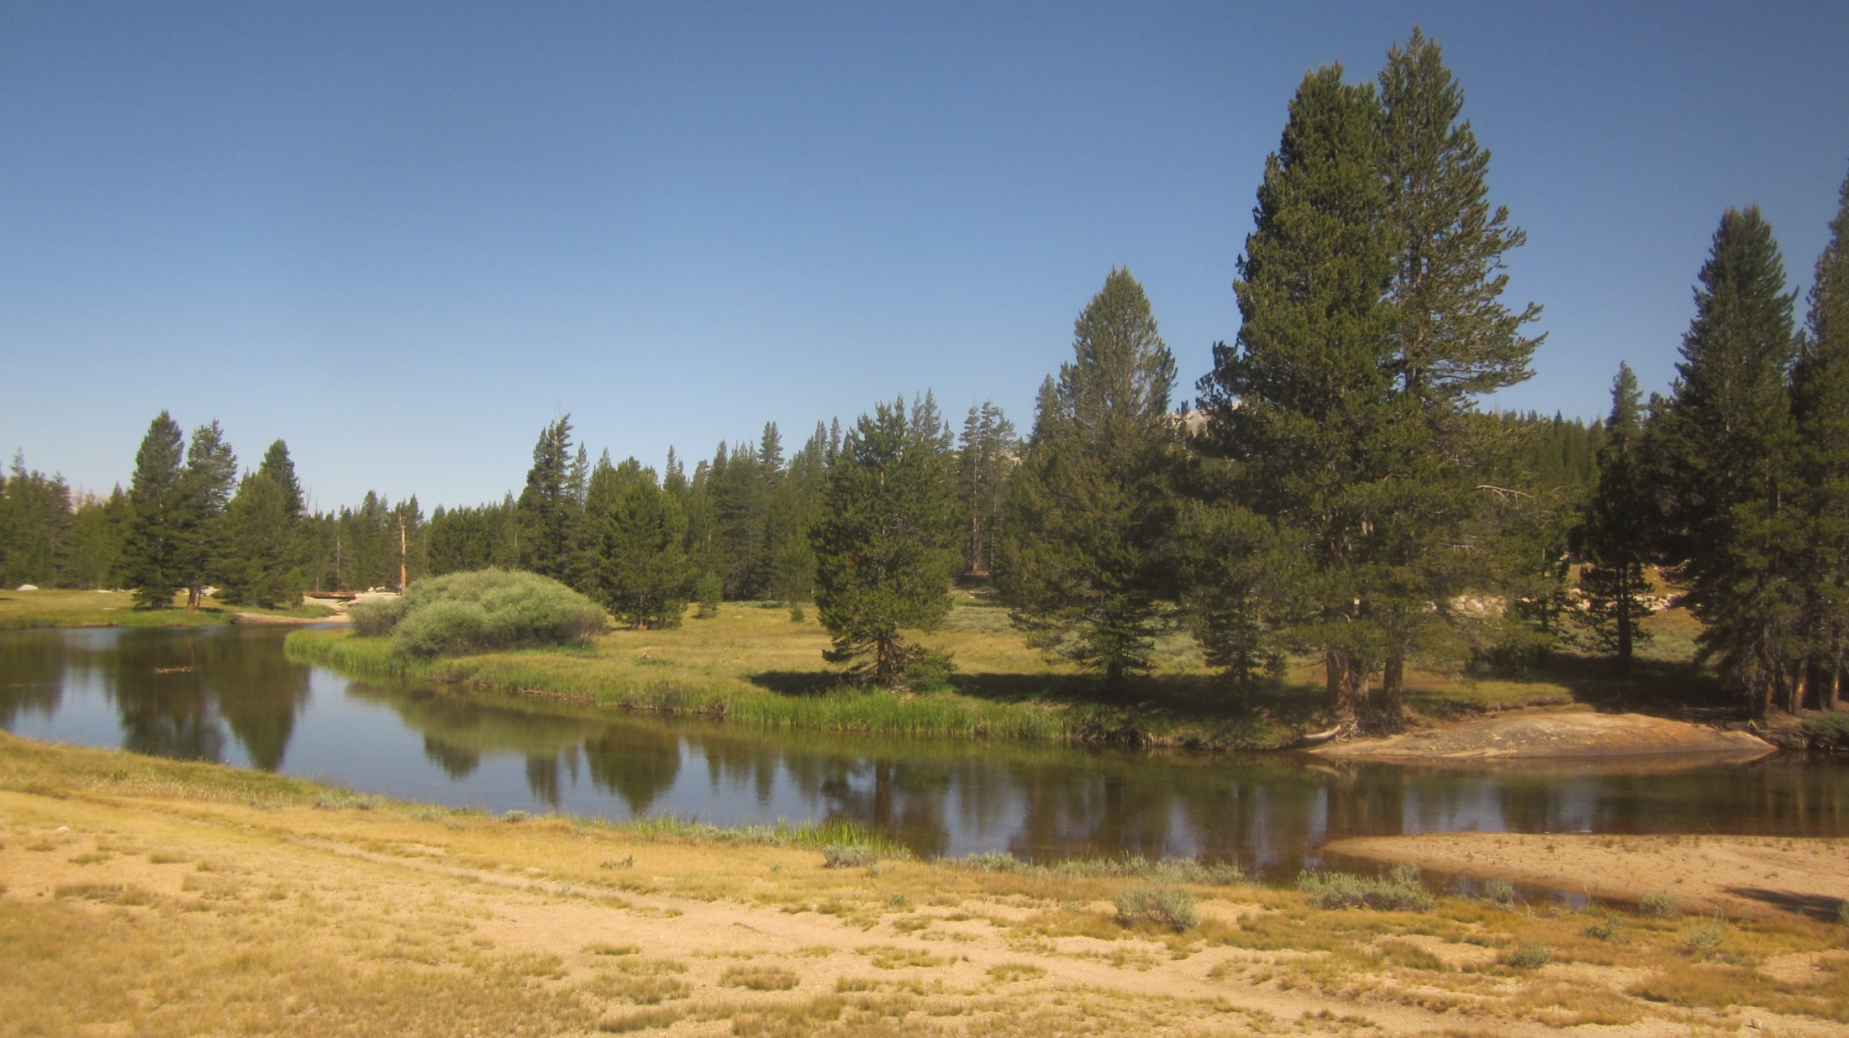
datalogger enclosure w/CR1000 install 7/16/2015 (hard to see)
corded Solinst (Silver model) inside stilling tube install 2002 CS450 P.T (strapped to stilling tube) install 7/16/2015
FLOW
Photo: 7/17/2015

Slide 3
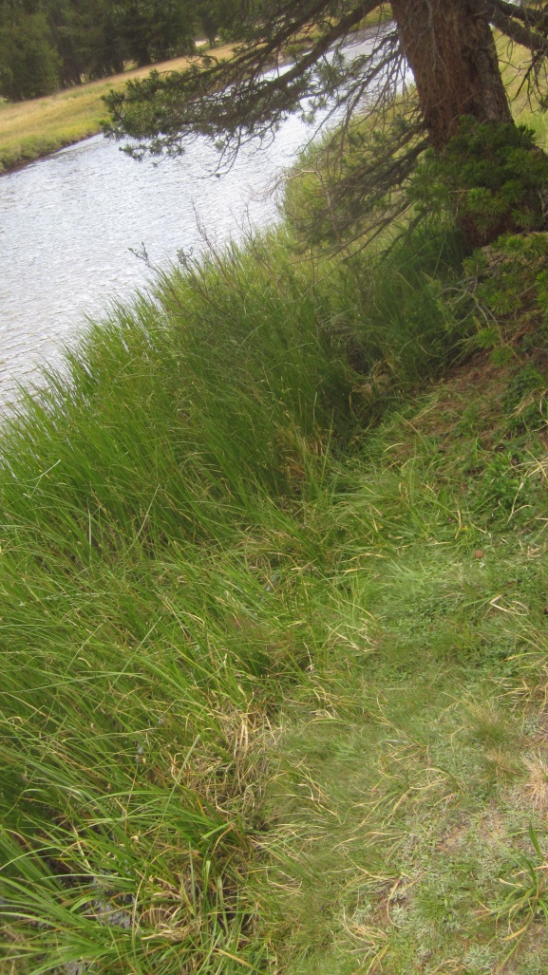
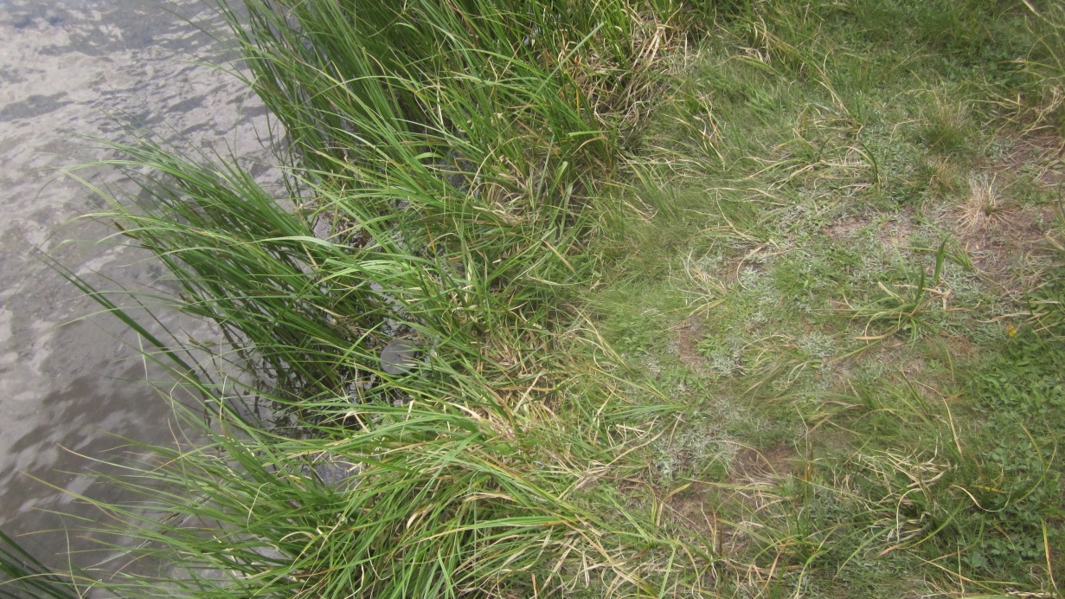
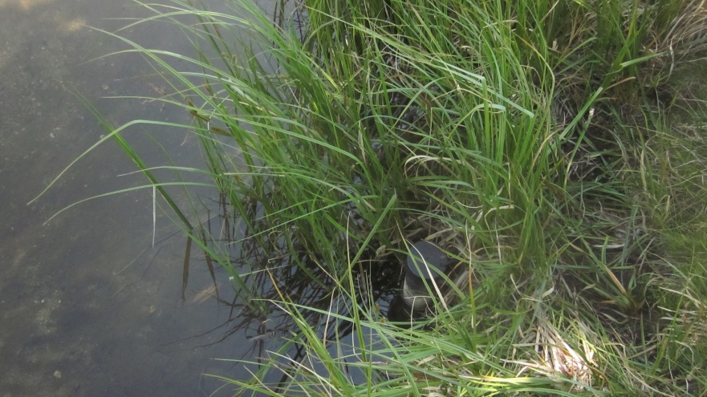
datalogger enclosure w/CR1000 install 7/16/2015 (hard to see)
corded Solinst (Silver model) inside stilling tube install 2002 CS450 P.T (strapped to stilling tube) install 7/16/2015
Photos: 7/16/2015
stilling-tube-gage
Gage height = 10ft – tape down from top of tube to water surface
CS450 P.T.
offset to match gage height:
8.60 ft. 7/16/2015

Slide 4
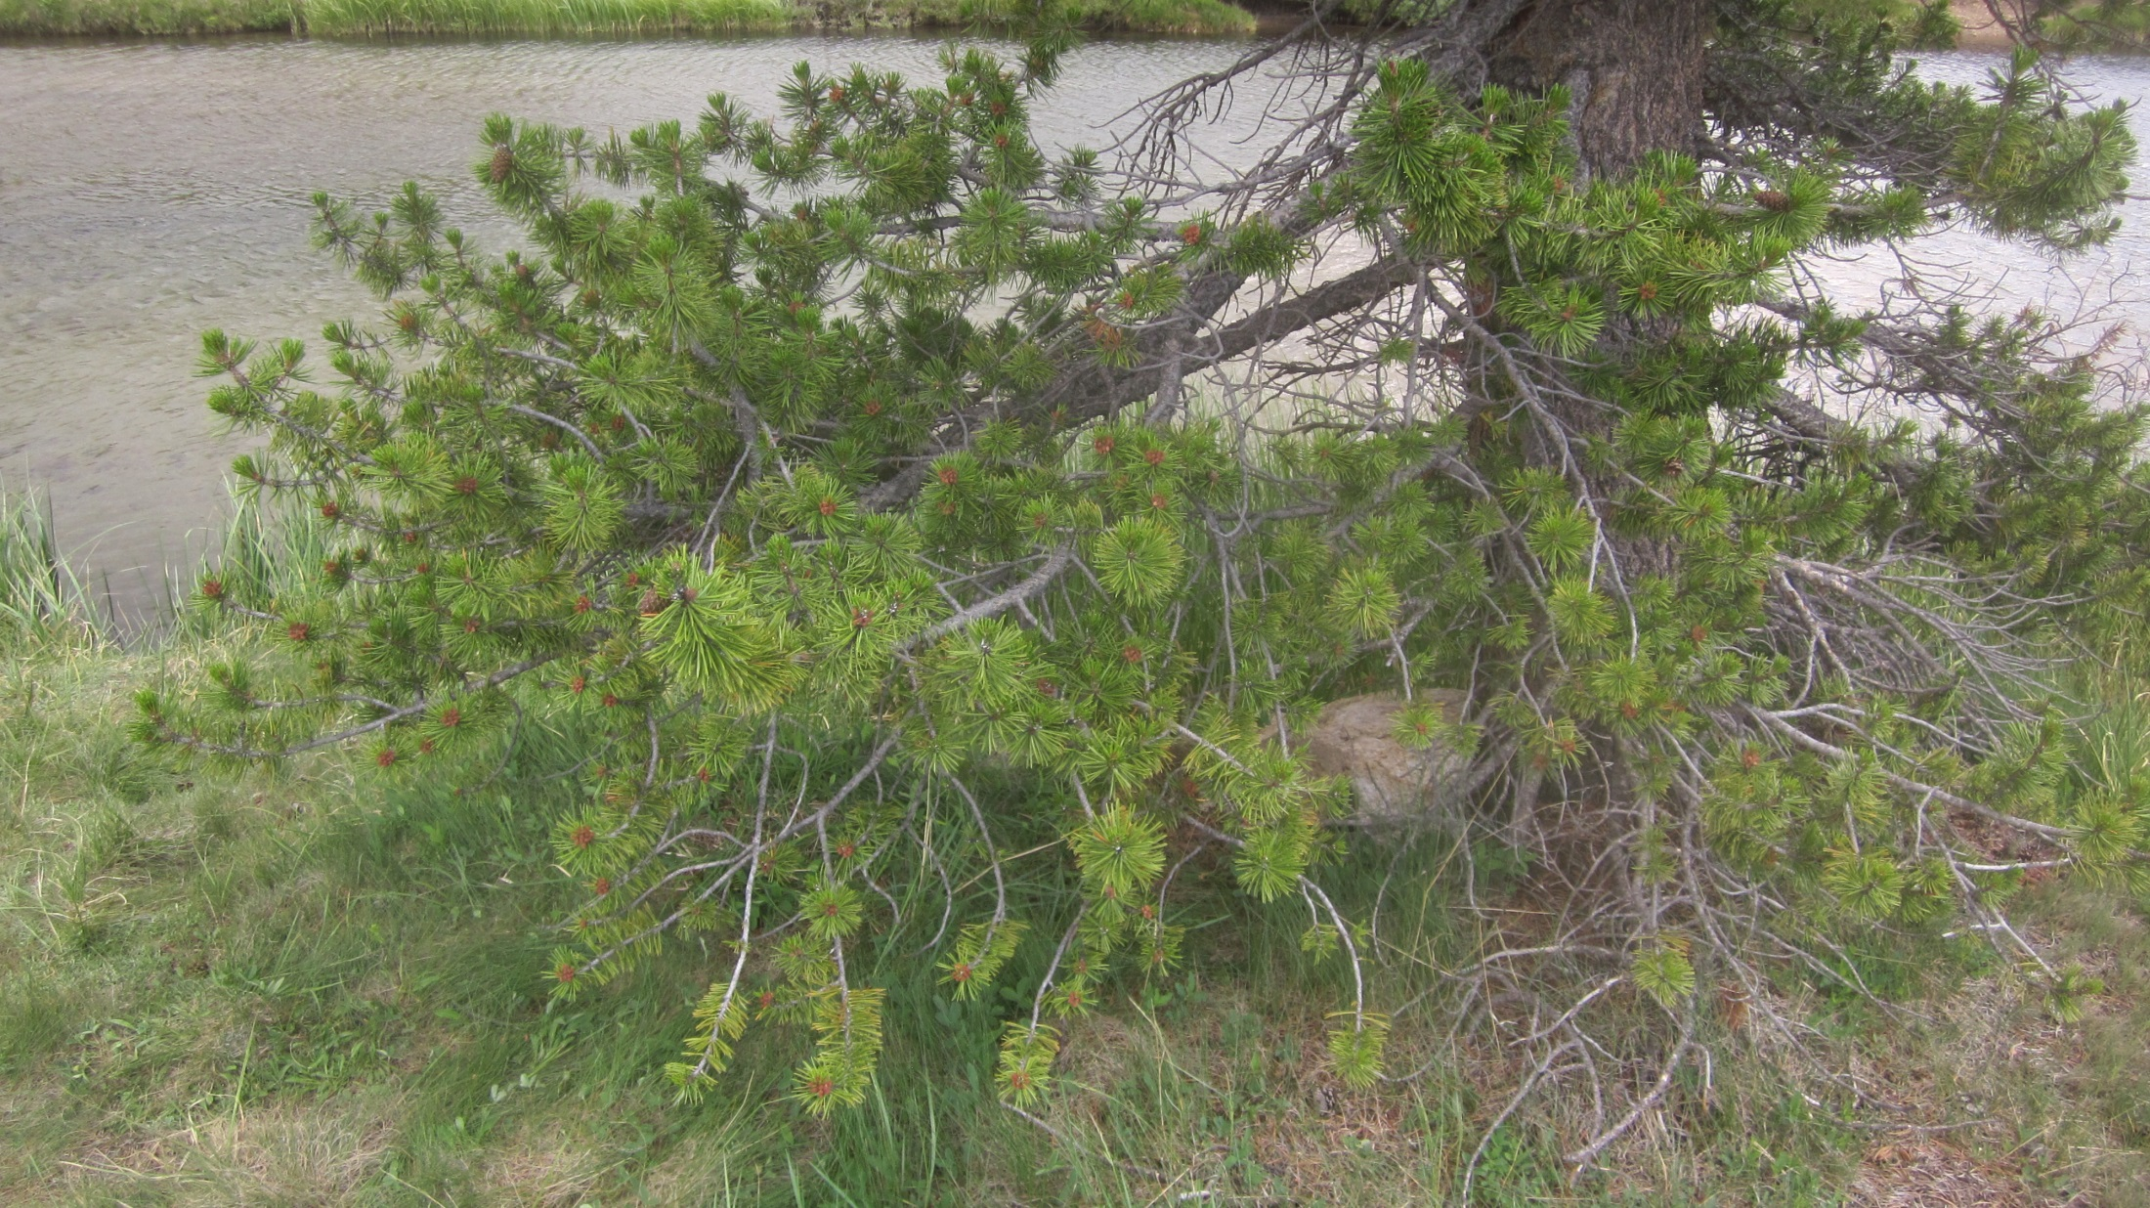
Datalogger enclosure
CR1000
CH100 solar control
12 Amp/hr internal battery
installed 7/16/2015
Solinst cord tupperware container
installed 2002 (hard to see)
Photo: 7/16/2015

Slide 5
bed-rock control (moderate-high flow)
bolt benchmark, install 7/16/2015
Photo: 7/17/2015
gravel-bar control (low-flow)

Slide 6
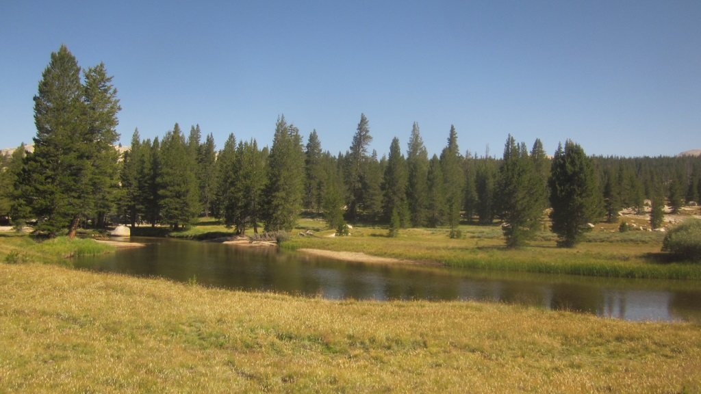
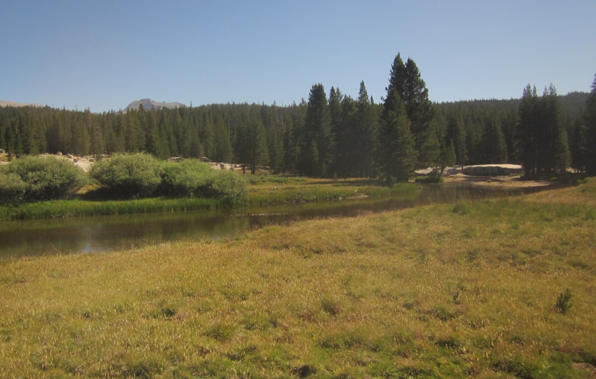
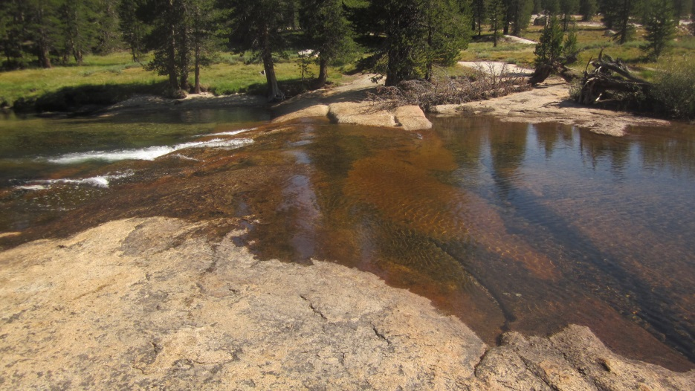
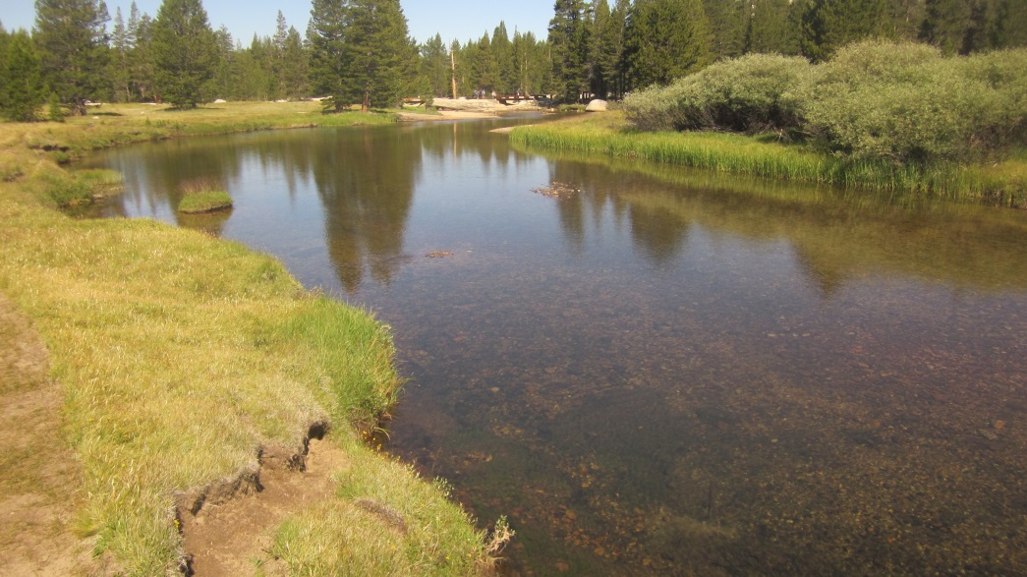
bed-rock control (moderate-high flow)
stilling tube gage, installed 2002
gravel-bar control
(low flow)
bed-rock control
gravel-bar control
Photos: 7/17/2015

Slide 7
Gage height on 7/17/2015 @ 9:15:
10ft – 0.78ft = 9.22ft
PZ0 – bed rock control: 8.54ft
PZ0 – gravel bar control: 7.72ft
bed-rock control
(moderate-high flow)
Gage Height of Zero Flow on 7/17/2015 @9:30:
9.22ft – 0.68ft = 8.54 ft
gravel-bar control
(low flow)
Gage Height of Zero Flow on 7/17/2015 @9:35:
9.22ft – 1.50ft = 7.72 ft
bed-rock control
gravel-bar control
Photos: 7/17/2015

Slide 8
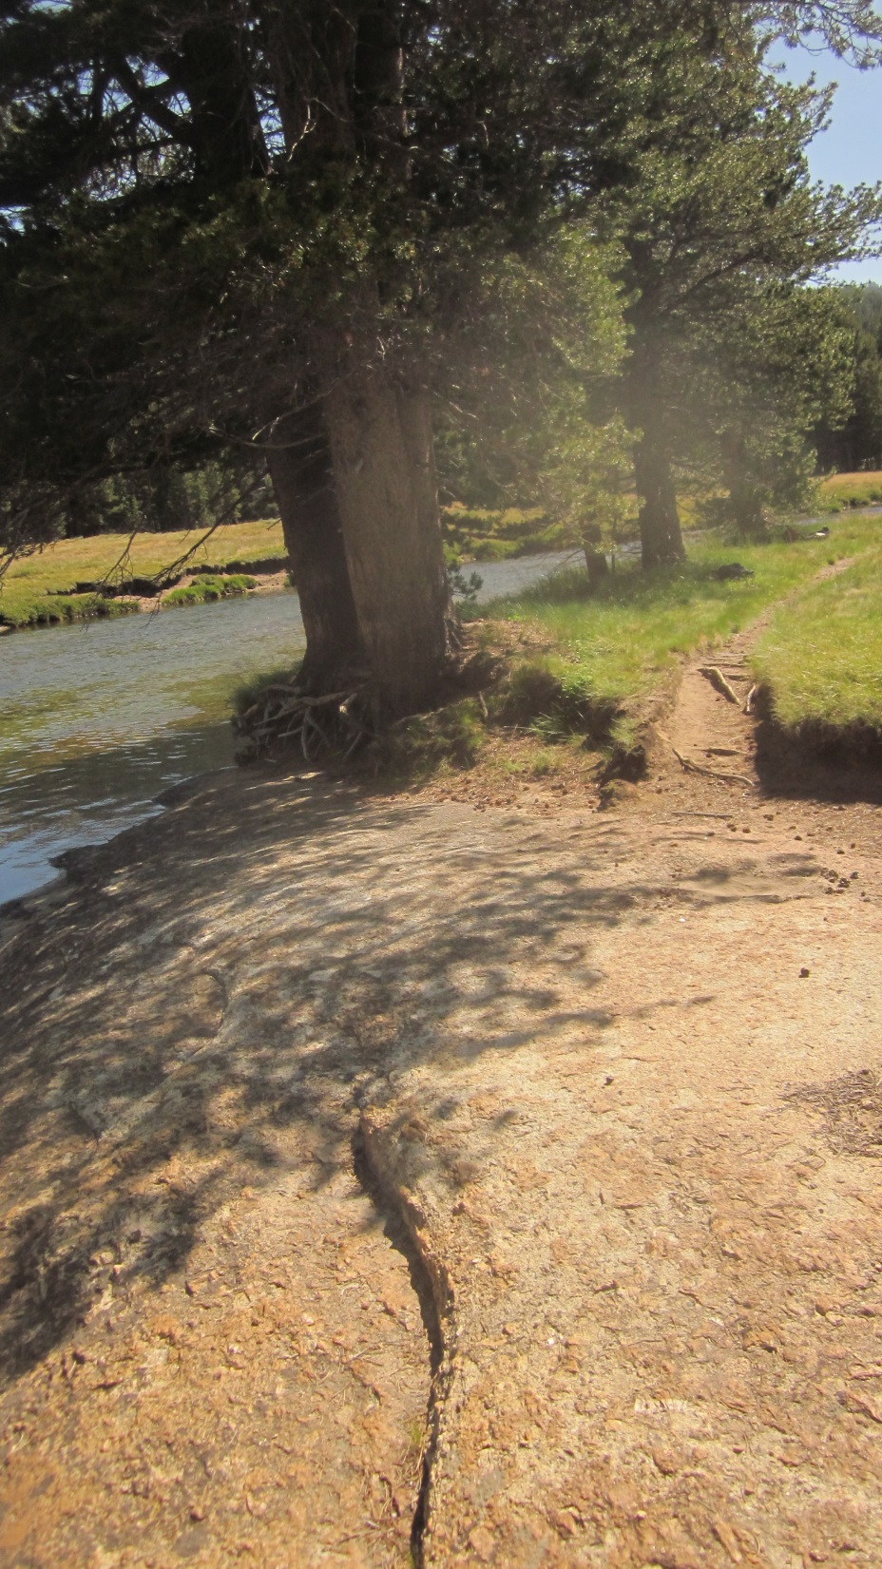
7/15/2015 level survey
Location | Benchmark manufacturer #s on stainless bolt heads | Time | Actual Survey Rod measurements (ft.) | Relative Elevations (ft) with making BM1=100.0' | Height of Instrument
BM1 | F593CTHE | 15:25 | 4.585 | 100 | 104.585
Top of stilling tube | NA | 15:25 | 5.645 | 98.94
BM1 - GH 10ft. Diff |  |  |  | 1.06
New Tripod |  | New Tripod
BM1 | F593CTHE | 15:35 | 4.721 | 100 | 104.721
Top of stilling tube | NA | 15:35 | 5.78 | 98.941
BM1 - GH 10ft. Diff |  |  |  | 1.059
Stilling-tube-gage
Installed 2002
7/16/2015 level survey
*after stilling tube set-screw install (Diff: + 0.023 ft) *
Location | Benchmark manufacturer #s on stainless bolt heads | Date Time | Actual Survey Rod measurements (ft.) | Relative Elevations (ft) with making BM1=100.0' | Height of Instrument
BM1 | F593CTHE | 7/16/2015 15:25 | 4.729 | 100 | 104.729
Top of stilling tube with set screw | NA | 7/16/2015 15:08 | 5.765 | 98.964
BM1 - GH 10ft. Diff |  |  |  | 1.036
Top of stilling tube without set screw | NA | 7/15/2015 15:35 |  | 98.941
Top of stilling tube with set screw | NA | 7/16/2015 15:25 |  | 98.964
 |  |  |  | 0.023 | Diff
Distance from stilling
Tube center to BM1:
57.55ft.
BM1 Bolt (ID# F593CTHE)
Installed 7/16/2015
Photo: 7/16/2015

